Slide 1
SQL - Joins
ERD - Brief Review
Why using JOIN?
JOIN Statement
INNER JOIN
LEFT JOIN
RIGHT JOIN
FULL OUTER JOIN

Slide 2
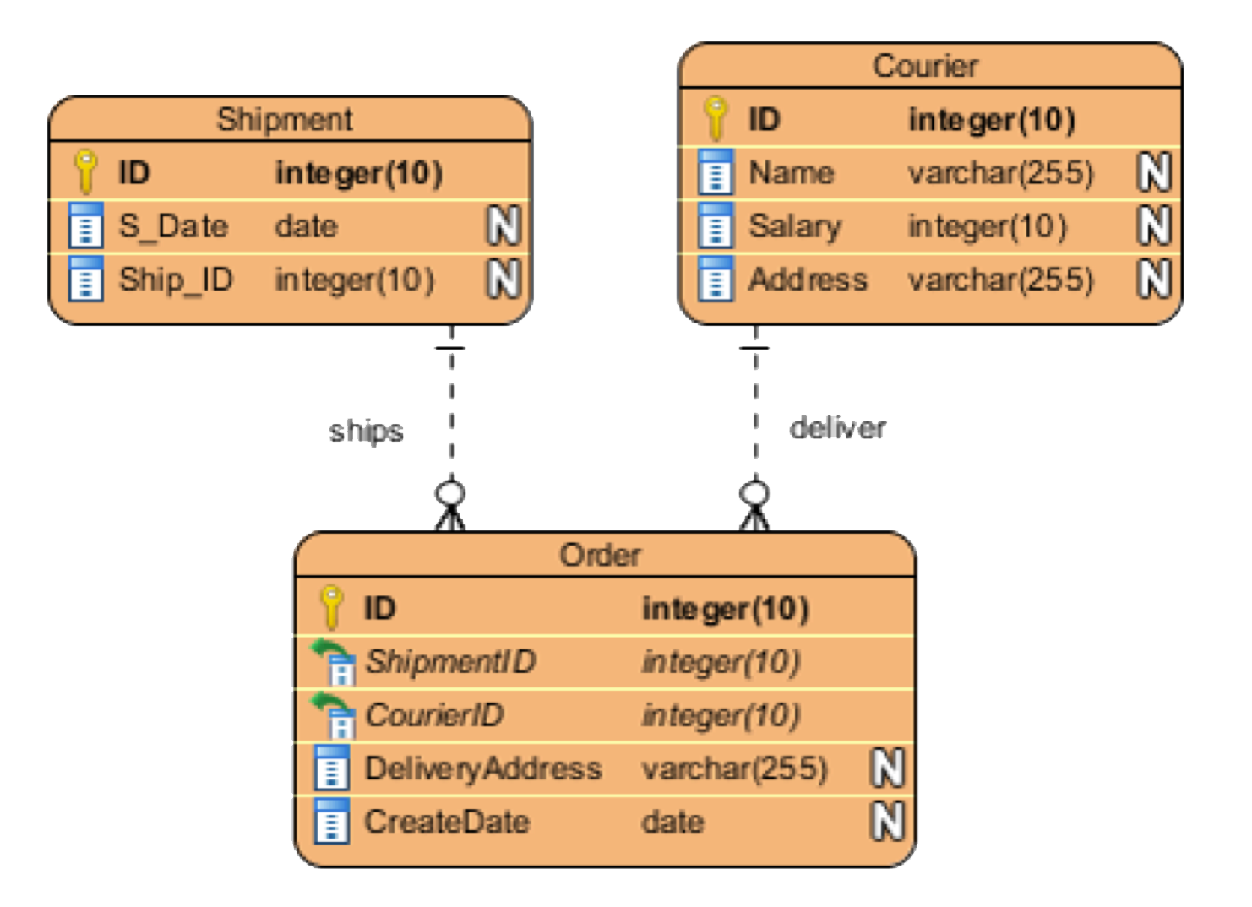
Using multiple tables
Take a look at our friend, the ERD:
So far, we just used one entity
Power of SQL comes from the fact we can run queries against multiple tables at once
JOINS are the statement we use to ‘connect’ the tables together
Joins work thanks to Normalization, a design technique that reduces data redundancy

Slide 3
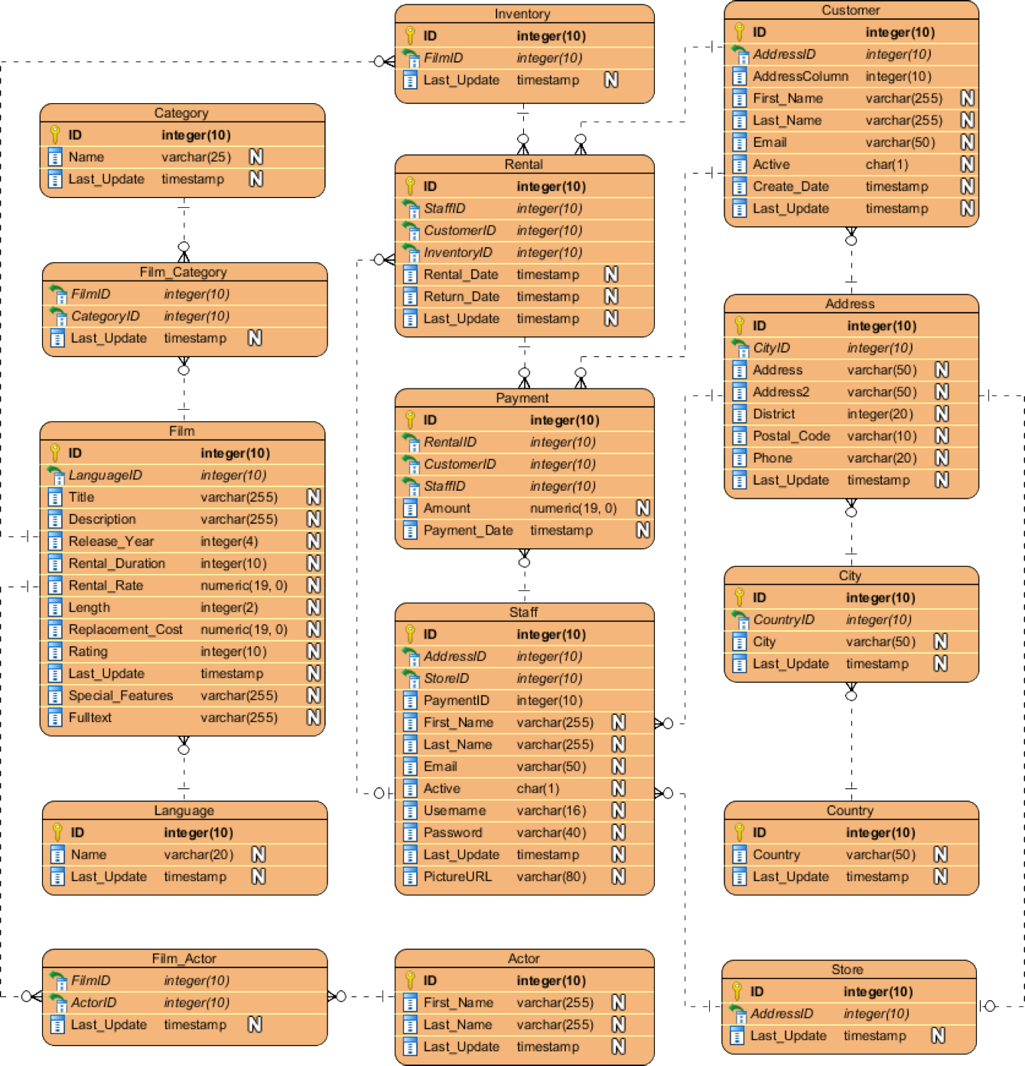
ERD Brief Review

Slide 4
ERD Brief Review
Primary Key (PK): Unique identifiers
Foreign Key (FK):
Is a column in one table which is a PK
Crow’s foot:
Indicates many of the instances of a FK
Dash line:
indicates only one instance of PK will be present in this table

Slide 5
ERD Brief Review
One to Many relationships
Each Customer has a unique ID.
ID it is the PK of the customer table
Thus, we will find a single ID for each customer
This ID is also present in the Rental, Payment
In those tables, it is present as a FK
Thus, we might find the same Customer ID for many rental operations.

Slide 6
ERD Brief Review
Many-to-Many relationships
There are many categories
There are many films
One film can have many categories
One category can be related to many films
Since PKs have to be unique, many to many relationships have to resort to a intermediate step (Film Category)

Slide 7
Why using JOIN?
How can we leverage these relationships?
As many tables are connected, we can perform interesting analyses
We can see, for example, the stores in UK
Let’s see this without using JOIN first

Slide 8

Why using JOIN?
First, let’s find the UK id
SELECT * FROM country
WHERE country = ‘United Kingdom’;
We can look cities whose country_id =102

Slide 9
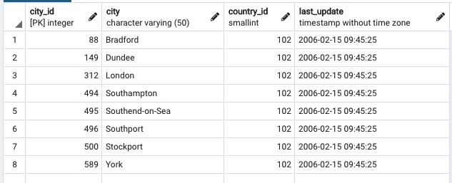
Why using JOIN?
SELECT * FROM city
WHERE country_id = 102;

Slide 10
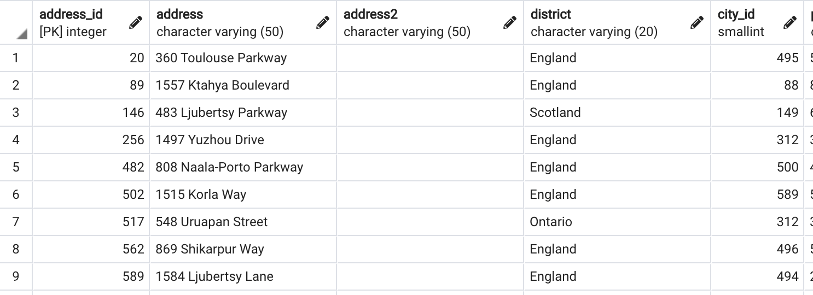
Why using JOIN?
SELECT * FROM address
WHERE city_id IN (88, 149, 312, 494, 495, 496, 500, 589);

Slide 11
Why using JOIN?
The process is tedious
We have to code the IDs manually
We can’t guarantee that we got all the IDs
JOIN makes this process simple
There are four type of JOIN

Slide 12
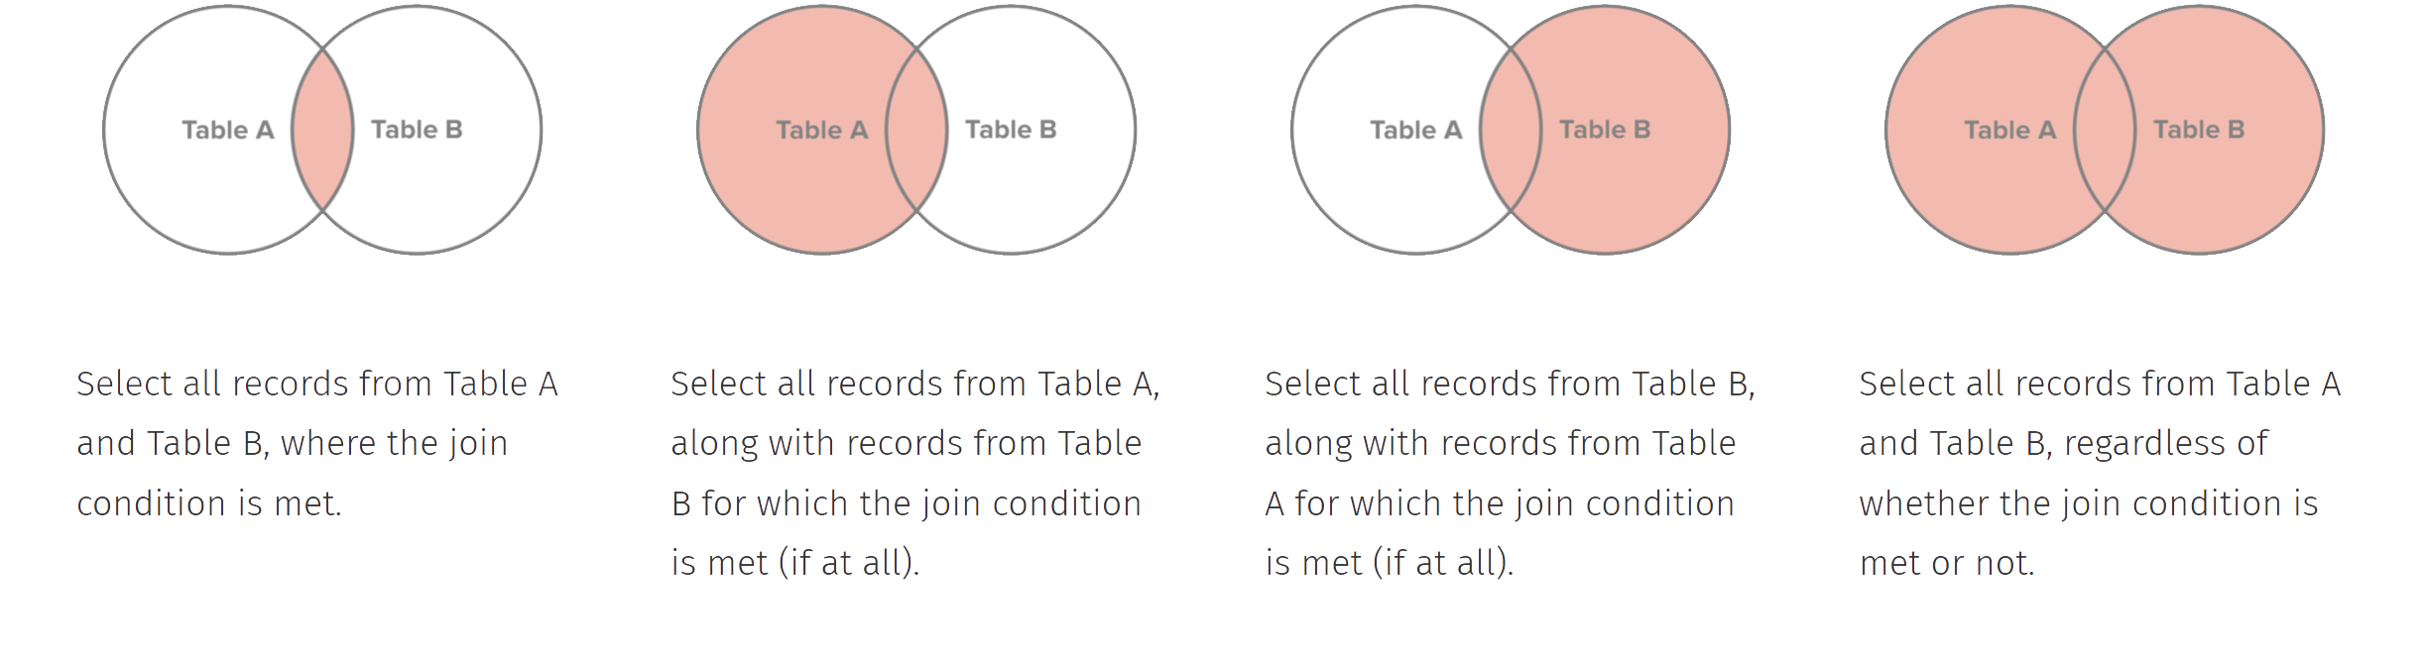
JOIN Statements
There are four type of JOIN:
INNER JOIN
LEFT JOIN
RIGHT JOIN
FULL OUTER JOIN

Slide 13
JOIN Statements - INNER
INNER JOIN: Connects rows based on a condition known as the join predicate. It has the same functionality as JOIN (pure syntactic sugar when you have different type of JOINs)
SELECT {columns} FROM {table_1} JOIN {table_2}
ON {table_1}.{common_key_1} = {table_2}.{common_key_2}

Slide 14
JOIN Statements - INNER
SELECT *
FROM country
JOIN city
ON country.country_id = city.country_id
WHERE country = 'United Kingdom';

Slide 15
JOIN Statements - INNER
We can JOIN ON more than one table
SELECT *
FROM address
JOIN city
ON address.city_id = city.city_id
JOIN country
ON city.country_id = country.country_id
WHERE country = 'United Kingdom';

Slide 16
JOIN Statements - INNER
We might want to get only the columns that belong to a certain table
SELECT address.*
FROM address
JOIN city
ON address.city_id = city.city_id
JOIN country
ON city.country_id = country.country_id
WHERE country = 'United Kingdom';

Slide 17
Aliasing
Aliasing allows us to create temporary variables which we can reference in our query
Typically we alias our tables as just the first letter of the table name
We can actually omit the AS, but it’s in this example for clarity
SELECT address, city
FROM address AS ad
JOIN city AS ci
ON ad.city_id = ci.city_id
JOIN country AS co
ON ci.country_id = co.country_id
WHERE country = 'United Kingdom';

Slide 18
Challenges
Find the addresses of all the stores
Return the first names, last names, addresses, districts and postal code for all the staff in the database
Return the first names, last names, addresses, districts and cities of customers who have rented a film
Return the first names, last names, addresses, districts and cities of customers who have rented a film between 26/05/2005 and 29/05/2005. Limit the results to 25 customers and sort the results by the last names in ascending order

Slide 19
JOIN Statements - LEFT
There are four type of JOIN:
INNER JOIN
LEFT JOIN
RIGHT JOIN
FULL OUTER JOIN

Slide 20
JOIN Statements - LEFT
LEFT JOIN
The left table will have every row returned
Matches every row to the row in the right table (based on the ON condition)
If the ON condition is True, columns from both tables are combined
If the ON condition is False, a new row is still added but with a NULL value

Slide 21
JOIN Statements - LEFT
There might be some stores with no clients registered:
SELECT as.address_id, cu.*
FROM address AS ad
LEFT JOIN customer AS cu
ON ad.address_id = cu.address_id
- WHERE cu.customer_id IS NULL;

Slide 22
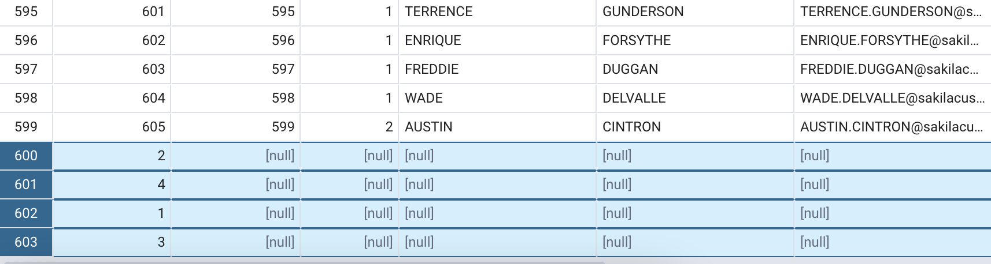
JOIN Statements - LEFT
There might be some stores with no clients registered:

Slide 23
JOIN Statements - RIGHT
There are four type of JOIN:
INNER JOIN
LEFT JOIN
RIGHT JOIN
FULL OUTER JOIN

Slide 24
JOIN Statements - RIGHT
RIGHT JOIN
Very similar to LEFT JOIN
The output is similar, but just switched positions
SELECT as.address_id, cu.*
FROM customer AS cu
RIGHT JOIN address AS ad
ON cu.address_id = ad.address_id;

Slide 25
JOIN Statements - FULL OUTER
There are four main type of JOIN:
INNER JOIN
LEFT JOIN
RIGHT JOIN
FULL OUTER JOIN

Slide 26
JOIN Statements - FULL OUTER
FULL [OUTER] JOIN
Take all data from both tables, regardless of the matches.
Let’s see the example from the previous slides (The employees exercise)
SELECT *
FROM employee_details AS det
FULL OUTER JOIN employee_salary AS sal
ON det.employee_id = sal.employee_id;

Slide 27
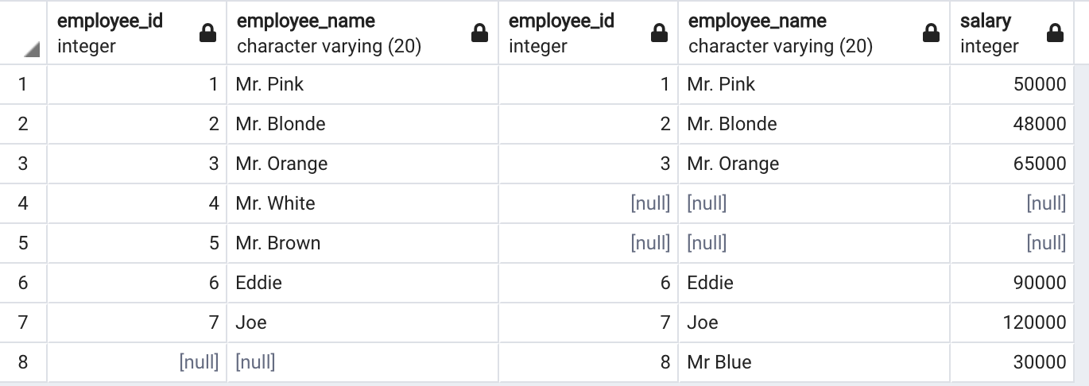
JOIN Statements - FULL OUTER

Slide 28
JOIN Statements - FULL OUTER
FULL [OUTER] JOIN
Rare use case
Discussion about its uses: https://stackoverflow.com/questions/2094793/when-is-a-good-situation-to-use-a-full-outer-join

Slide 29

JOIN Statements
There are four type of JOIN:

Slide 30
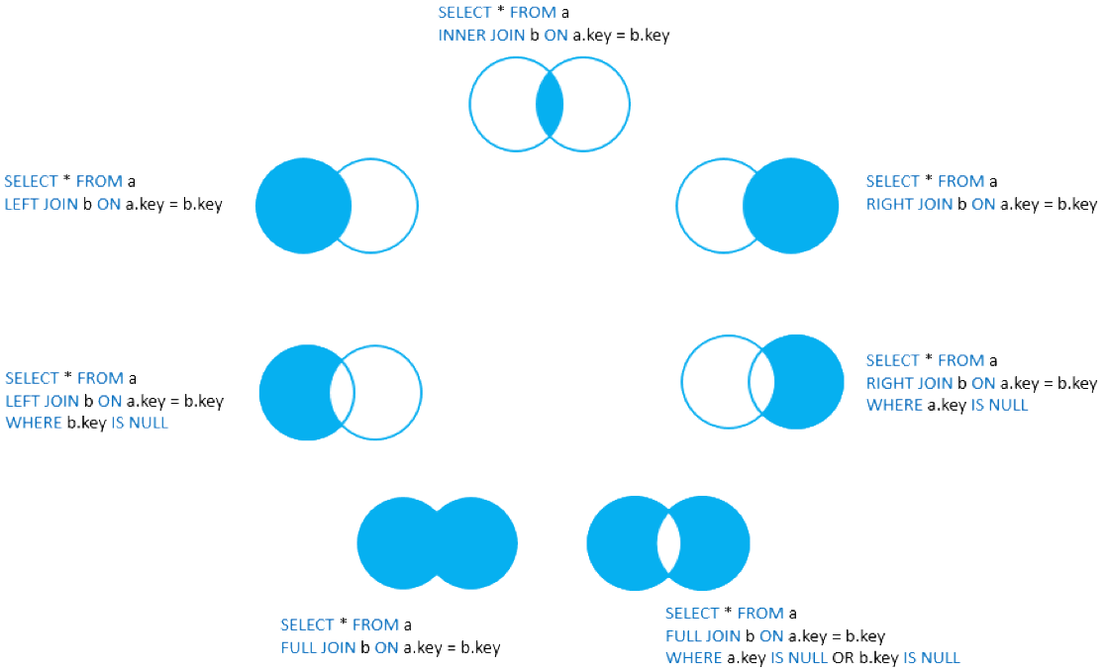
JOIN Statements
https://www.postgresqltutorial.com/postgresql-joins/

Slide 31
Challenges
customerID | customerName
1 | Homer
2 | Marge
3 | Bart
4 | Lisa
5 | Maggie
6 | Moe
orderID | customerID | item
1 | 1 | Beer
2 | 2 | Hair product
3 | 2 | Dress
4 | 3 | Juice
5 | 3 | Magazine
6 | 6 | Peanuts

Slide 32
Challenges
Given the following SQL statement:
SELECT c.customerID, c.customerName, o.item FROM customer AS c INNER JOIN order AS o ON c.customerID = o.customerID
What is the:
Number of columns in returned table?
Number of rows in returned table?
Number of times customerID “2” would show up?
Number of times customerID “5” would show up?

Slide 33
Challenges
Given the following SQL statement:
SELECT c.customerID, c.customerName, o.item FROM customer AS c LEFT JOIN order AS o ON c.customerID = o.customerID
What is the:
Number of columns in returned table?
Number of rows in returned table?
Number of times customerID “2” would show up?
Number of times customerID “5” would show up?

